Slide 1






Code with RM0, the Malaysian way.

Slide 2
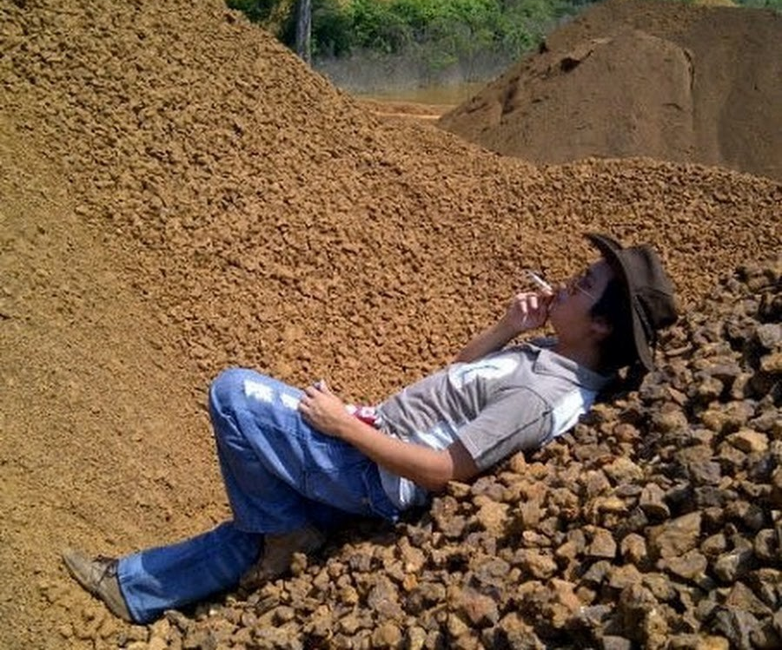
://Hello!
I am Adri ‘C-Fu’ Idzwan Mansor
I am a man of many hats
I am a Data Storage Specialist & SME Consultancy
I am doing Natural Disaster Monitoring, Damage Prevention, Assessment & Prediction
I love language – English-As-Code!

Slide 3

://the_goal
Become an AI polyglot
Model-agnostic practitioner
Sovereign AI operator
ORCHESTRATION ARCHITECT

Slide 4
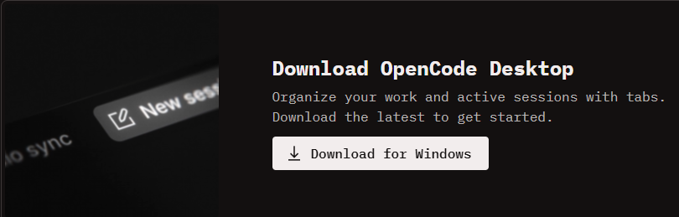
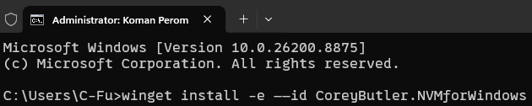
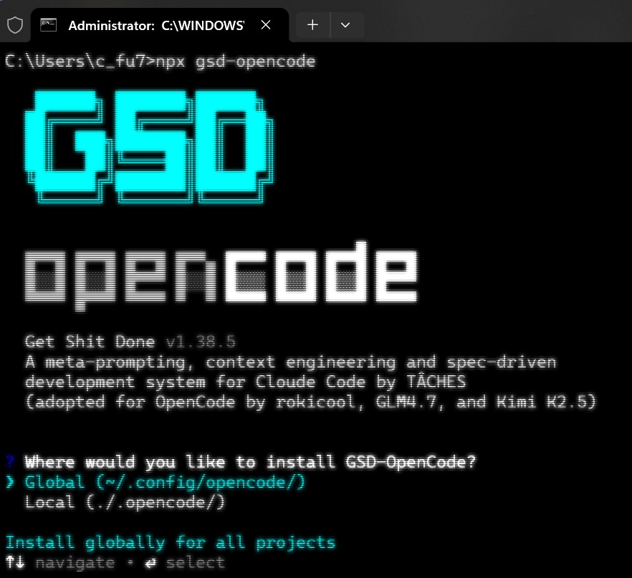
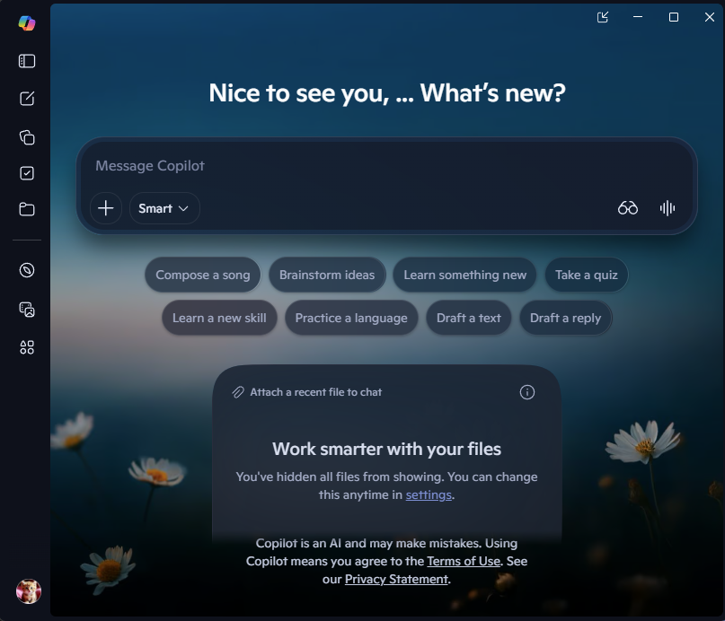
://checklist
OpenCode - https://opencode.ai/download
WinGet – Windows 11, Windows 10
NVM, npx, npm, node
gsd-opencode
https://github.com/coreybutler/nvm-windows/
--Or--
winget install -e --id CoreyButler.NVMforWindows
Microsoft Copilot (Or Gemini)
TOTAL COST: RM0

Slide 5
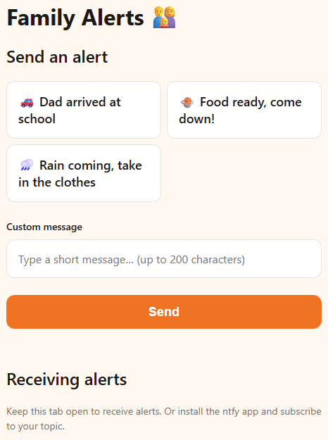
://recap_of_yesterday’s_speedrun
https://github.com/C-Fu/aimto2026
https://c-fu.github.io/aimto2026/
https://jomqr.my/c_fu

Slide 6


Need More Convincing?
Schedule a the tarik session!
You can find us at:
Ampang, Selangor/Gebeng, Pahang
c-fu@homelab.my
+6019-258-6568
Jomqr.my/c_fu

Slide 7
